Slide 1
OGZEB Hybrid Thermal Electrical
Energy Storage System
Fall 2013-Final Presentation
Team members: Corey Allen, Anthony Cappetto, Lucas Dos Santos, Kristian Hogue, Nicholas Kraft, Tristian Jones, Artur Nascimento
Sponsors/Advisors: Dr. Li, Dr. Ordonez, Dr. Zheng
Date: 12-5-2013
Notes:
Good Afternoon everyone, we are team 23 working on the ogzeb. Introduce everyone and mention our sponsors.

Slide 2
Outline
Project Scope/Objectives
System Design & Analysis
Prototype Integration & Testing
Tentative Procurement Options
Future Plans
Conclusion
Questions
Notes:
We’ll start with an overview of what we presented last time, then update you on the progress of the battery system. After that we’ll show you the development of the thermal energy storage system and present some procurement information, along with future plans, conclusions, and any questions you may have.

Slide 3
Project Scope
Design energy storage system to store excess power generated by the house’s solar cells to be used at night.
System will consist of an array of batteries and a thermal energy storage system.
Notes:
To review midterm 1, our team was told to design an energy storage system to keep the OGZEB powered while the solar panels are inactive. The system should be a combination of thermal and electrical energy storage.

Slide 4
Objectives
Develop a model of the house’s power needs to determine the best type, number, and arrangement of batteries for the house
Create an Ice Thermal Storage System in parallel to the house main air conditioning system.

Slide 5
Thermal Storage Design

Slide 6
Final Design Concept
Chiller cools water during the day.
Water cooled inside of tanks to be installed inside an air exchange box.
Tanks are designed to maximize heat transfer when air is drawn past them with the help of fins.
Air run directly over tanks into the house.

Slide 7
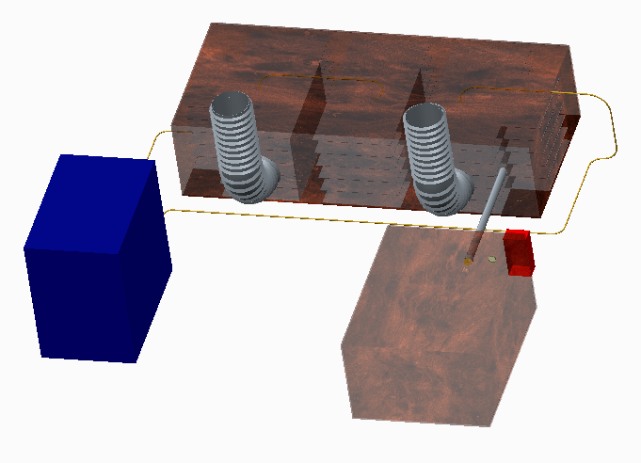
Original Design Visualization
Finned Water Tanks (3)
Air In
Air Out
Cold Glycol Into Box
Cool Air in
Warm Glycol Out
Chiller
Battery Container

Slide 8
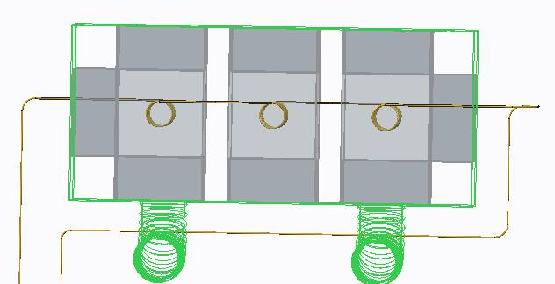
Fluid Process Flow Diagram
Water Tanks
Fins
Cold Glycol from Chiller
Warm Glycol to Chiller
Hot air in
Cold air out

Slide 9
Design Changes or Additions
Instead of using wood for construction of the air exchange box, will be used sheet metal with heavy thermal insulation around the outside perimeter.
To integrate the system in the house, the same AC system ducts will be used.
When the air conditioner is turned off a fan installed will impel the air into the air exchanger box.
A small door will be programmed to open or close at the airflow entrance and exit to close off the system during the daytime chilling process.
Heat rejection from chiller funneled into battery box for climate control

Slide 10
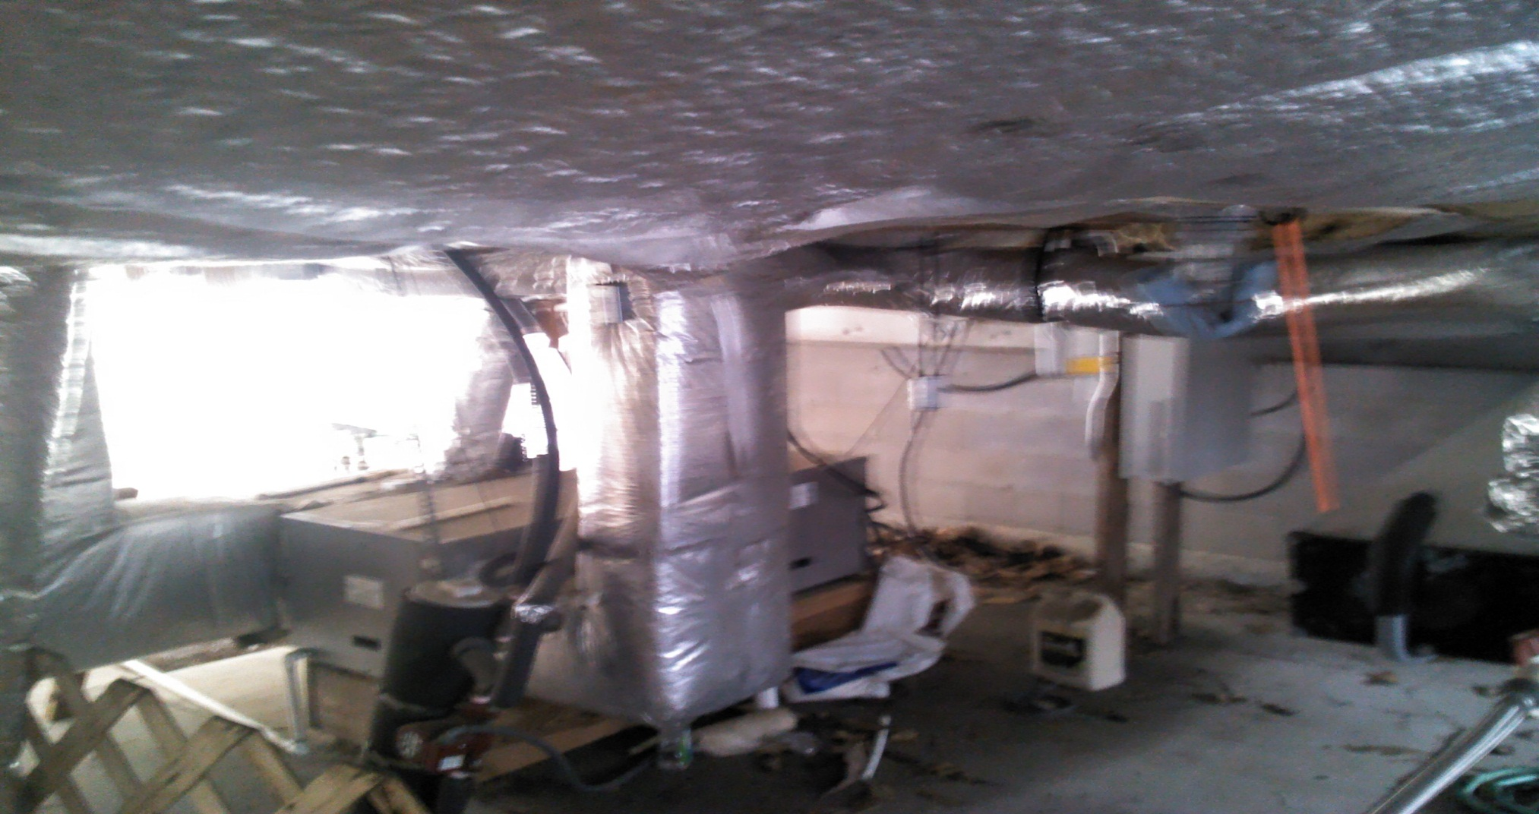
House Integration
Air ducts in and out of house
Enough room for system as designed
thermalsystem

Slide 11
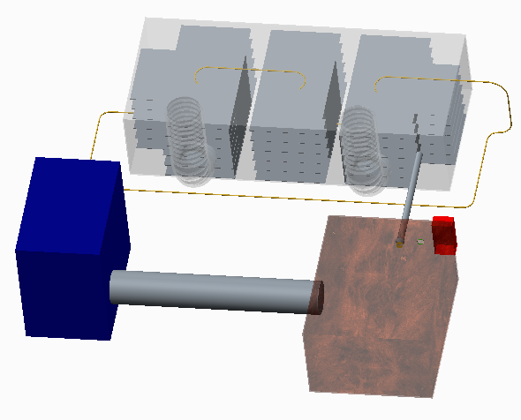
Design Addition
Chiller heat rejection to battery box

Slide 12
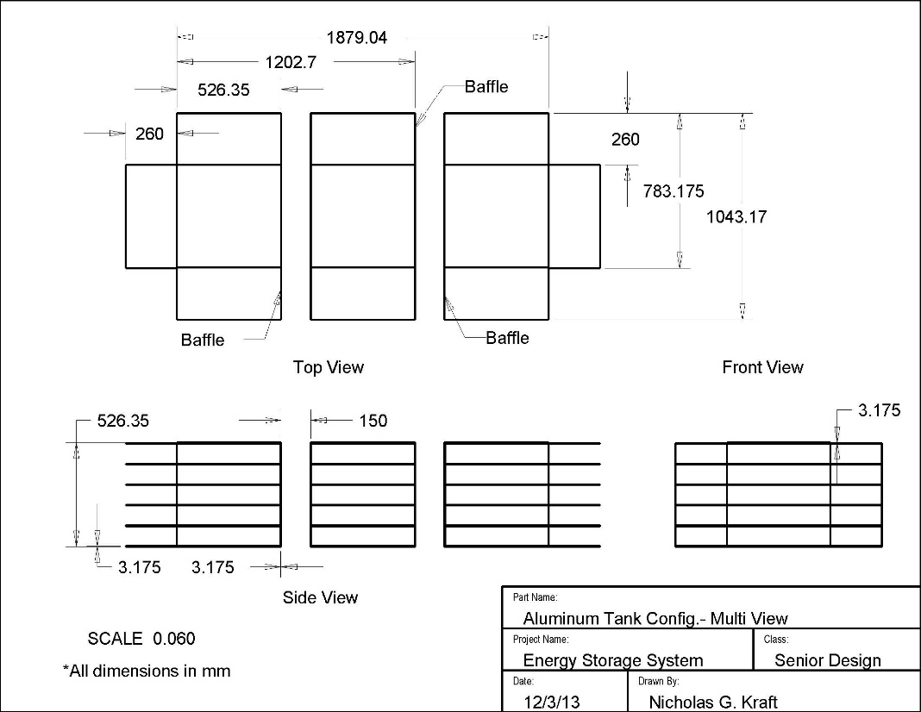
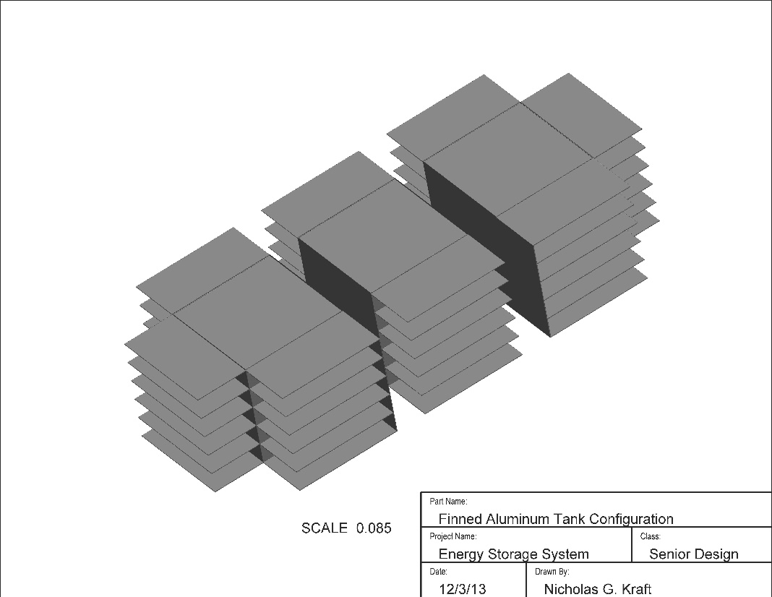
Detailed Design-Aluminum Tank Configuration

Slide 13
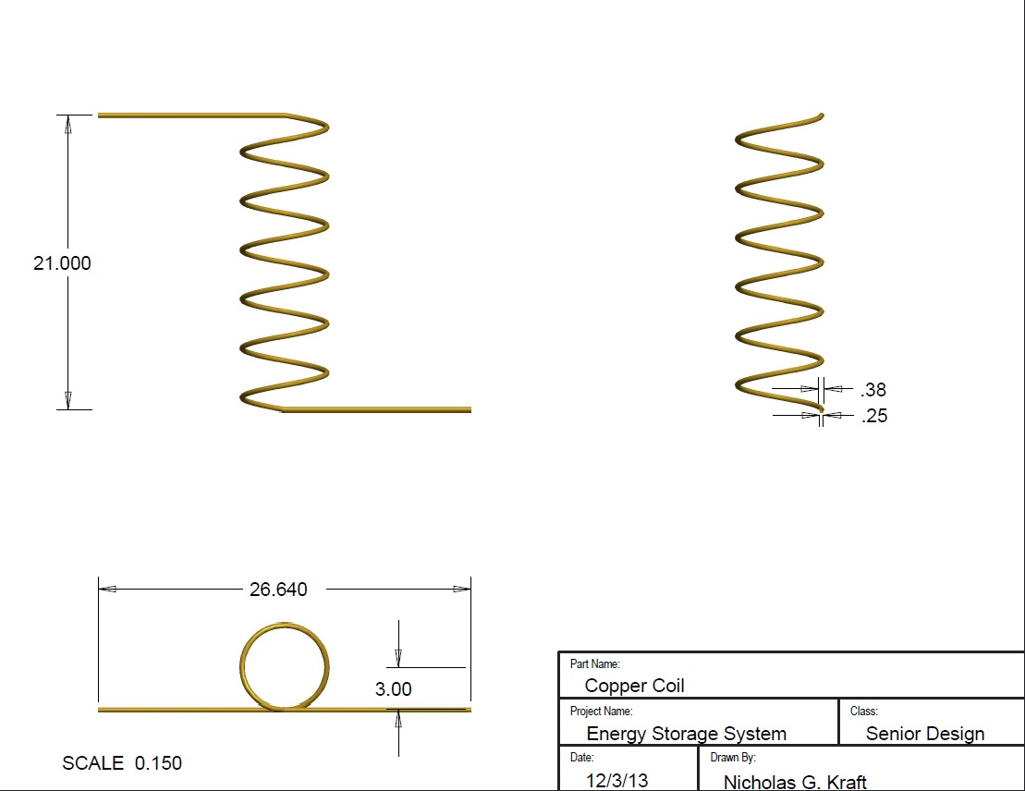
Detailed Design-Copper Coil

Slide 14
Ice Melt Analysis
For the analysis of the fin heat transfer, the assumption of an adiabatic fin tip was made due to the fin tip being up against the inside surface of the wood box.
Assumed ambient temperature of 20 C and ice temperature of 0 C.
Water latent heat of fusion = 334 kJ/kg
Total heat loss required to melt 400 L ice = 133.6 MJ
The heat loss rate through the NON-FINNED area of 3.13 square meters will be approximately 838W.
The total heat transfer for a fin (adiabatic tip) is given by:
The total heat transfer for a single aluminum fin was found to be 40.5 W.
If the total heat transfer for a single fin is multiplied by the number of fins (48 total), a total fin heat transfer rate can be calculated to be 1942 W.
If both the non-finned surface heat transfer and finned heat transfer are added together the combined total heat transfer (H) can be calculated to be 2780 W.
Finally, the melting time can be calculated:

Slide 15
What has been done
Using MATLAB we were about to run battery simulations of the house
Gathered Load Data (for a house of similar dimensions)
Acquired weather data to use for simulations
Ran simulations to give us an idea of battery lifetime
Did a cost analysis of different type of batteries for the house
Look at 3 different types of batteries
Compared to batteries life span
Also look at different configurations to increase power
Made a recommendation based on this analysis
Design a way to keep the batteries at a more stable temperature
Will be using a Arduino Uno Microprocessor with motors
The bulk of this part will be done in the upcoming semester

Slide 16
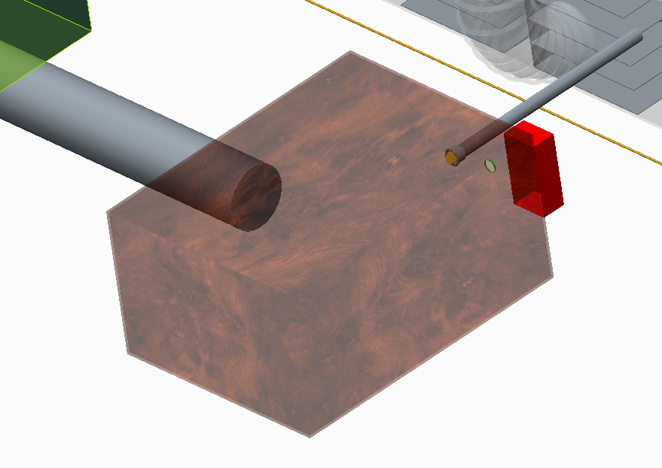
Battery Temp Regulation
Heat rejection from chiller used to warm batteries
Cold Air from system used to cool batteries
Valves
Battery Container
Temperature Sensor and valve actuator

Slide 17
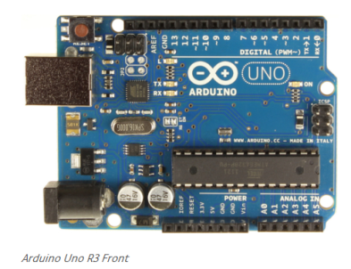
Battery Temp Regulation
Thermal Battery Management Specifications
- Arduino Uno Project Board
- 14 Digital outputs/inputs
- 6 of 14 are Digital PWM
- 6 analog input pins
- This board will be programed
to control the valves into the
battery boxes

Slide 18
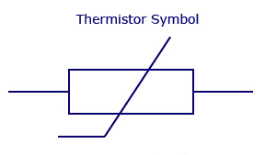
Other items
LCD screen to
display the temperature
2 Stepper motors
to control the valves
Thermostat or Thermistor
to observe the temperature
of the box

Slide 19
Additional Design Aspects
Roofing insulation will isolate the air exchange and battery boxes from the outside, to minimize heat transfer to environment
Air exchange box to have drain to remove condensation
If batteries begin to overheat, valve opens to allow cold air from the system to cool the batteries.
If batteries fall under minimum temperature, hot air from chiller input to battery box
Use of a filter to clean the air coming from the outside into air exchanger box, also removes odors
Doors to control air flow into/from house

Slide 20
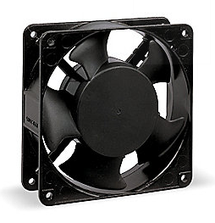
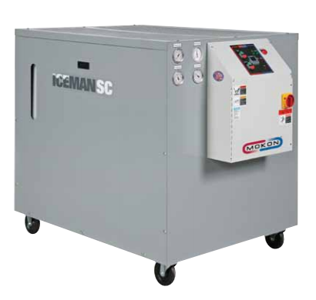
Additional Components
Chiller and fan to be purchased according to specs
Current design utilizes a Glycol Chiller and 870 CFM fan
Secondhand products may be available (Recycled products are a plus for the OGZEB)
Sheet metal and insulation can be bought from local hardware stores
Aluminum for water tanks available online

Slide 21
Prototype Integration & Testing
Original Plan is to put the thermal storage system in series with the main HVAC duct and in parallel with the main A.C. system by cutting into the main duct and attaching our own duct
The main A.C. system will run during the day and airflow will be impelled through the main house duct only
At night our fan will turn on which will impel the house air only through our duct which is attached to the inlet and outlet of both our system and the main duct
The prototype will be built first and tested using outside air before cutting into the main duct and installing the full system

Slide 22
Cost Analysis (Thermal)
Part | Supplier |  | Cost | Notes
Chiller | Mokon |  | $5920 | New (1 ton)
 | Ebay |  | $1250 - 2550 | Used, cosmetically unappealing (0.68 ton)
Fan | Grainger |  | $260 | 870 cfm
Water Tanks | Home Depot |  | $2.8 / sq. ft. | Weldable Aluminum
 | Storm |  | $18 / sq. ft. | Copper Sheet
Wood | Home Depot |  | $0.85 / sq. ft. | plywood
 | Home Depot |  | $2.50 / board | Board 2” x 4” x 8’
Insulation | Home Depot |  | $12 / pack | Fiberglass (roofing) 9.5” x 15” x 25’
Tubing | Grainger |  | $2.50 / ft. | Refrigeration coil 3/4” OD
 | Home Depot |  | $2.90 / ft. | Soft Copper Utility Coil
 | Home Depot |  | $1.40 / ft. | Copper Utility Coil
Minimum Total Estimated Cost |  | $2400 |  | Material only, does not include regulatory electronics, only for thermal system
Notes:
This is a table of our major components and they’re respective costs. The biggest expense is the chiller, followed by the aluminum needed for the air exchange box. From our initial design and estimations, our total estimated cost for the thermal storage system is around $2400. This does not include the electronics needed to control how often the system runs.

Slide 23
Problems Encountered
Sponsor disagrees with battery selection, citing possible maintenance costs
Discussion and further analysis necessary
Sponsor concerned with keeping the batteries warm during winter
Possible solution created by using waste heat from chiller
Lack of defined budget is hindering team from continuing
Meeting with all sponsors and faculty to take place next to discuss budget issue

Slide 24
Conclusion
Further discussion necessary to determine correct battery selection
Thermal energy storage system design concept complete
Size of system will be determined based on available budget, to be decided next week
Suppliers and parts located
Notes:
So in conclusion our team has designed an appropriate battery system, and has completed a detailed design of the thermal energy storage system. All the necessary parts have also been found and priced.

Slide 25
Future Plans
Meet with all faculty sponsors and advisors to determine budget
Determine possible size of system
Order materials
Install battery array
Begin to build the energy management system prototype.
Evaluate potential of adapting system to work during the winter, when AC use is unnecessary.
Notes:
In the immediate future, our team would like to conduct a detailed thermal analysis of the system and find ways to make the system smaller. We will also be ordering materials, and installing the battery system very soon. Next semester we will devote more time to integrating the systems into the house and adding features if time allows. Now we will take a few questions.

Slide 26
Future Plans
Try to improve the energy management system for the battery system
prevent over charging of the batteries. This decreases battery life
Create future management system for possible grid connection
Programming of the microprocessor
This will control the temperature of the batteries and extend battery life
Connecting back to the grid
Talking to the power company to get minimum requirements
Research a bi-direction converter used for connection to grid

Slide 27
Questions

